Slide 1


Fiscal Policy and the Ethno-Racial Divide: Bolivia, Brazil and Uruguay
Nora Lustig
Tulane University
Inter-American Development Bank
Washington, DC, November 21, 2013

Slide 2
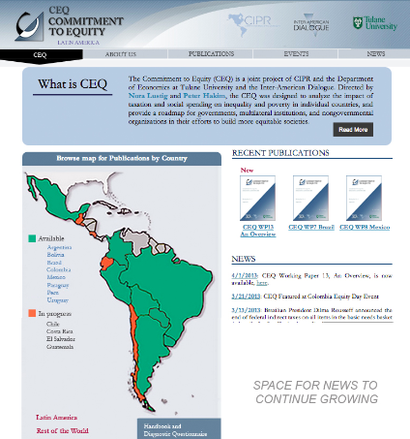
Commitment to Equity (CEQ) www.commitmentoequity.org

Slide 3
CEQ by Ethnicity and Race
Bolivia: Paz-Arauco, Grey-Molina, Jimenez and Yañez
Brazil: Higgins and Pereira
Guatemala: Cabrera, Lustig and Moran
(under verification)
Uruguay: Bucheli, Rossi and Amabile

Slide 4
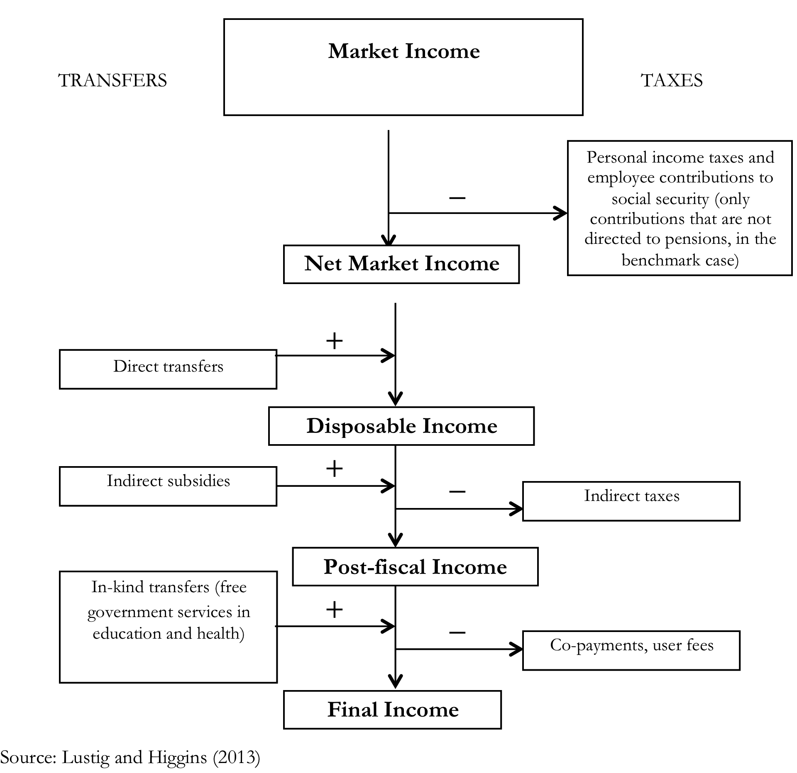

Slide 5
Budget Size and Composition
Primary and Social Spending as % of GDP
Notes:
Size matters but is not destiny. Uruguay showed was number 2 in terms of redistribution and number 1 in terms of poverty reduction but its budget size is close to Mexico´s.
In Peru, fiscal space, however, may be a restriction.

Slide 6
Fiscal Policy and Inequality
Gini Coefficient by Income Concept

Slide 7
Fiscal Policy and Poverty
Headcount Ratio

Slide 8
Measuring the Ethno-Racial Divide
Poverty: poverty rates by ethnic and racial groups and the ethno-racial composition of the poor
Inequality: ratio of income per capita between and the distribution of population within groups
Inequality of opportunity: a measure of equalization of incomes across circumstances
Equity in Public Services: use of public education and health services by ethnic and racial groups

Slide 9
Poverty
Headcount Ratio US2.50ppp/day

Slide 10
Ethno-Racial Composition of the Population by Income Class
(thresholds from Ferreira et al., 2013)

Slide 11
Ethno-Racial Composition of the Population by Income Class
Market and Disposable Income

Slide 12
Ratio of Income Per Capita Between Ethno-Racial Groups

Slide 13
Distribution of the Population by Income Class
(thresholds from Ferreira et al., 2013)

Slide 14
Distribution of the Population by Income Class
Market and Disposable Income

Slide 15
Equalizing Opportunities

Slide 16
Assessing Characteristics of Fiscal Interventions
Progressivity:
  Taxes:
    Progressive if share paid is higher than market income share for ethno-racial group with higher per capita income
    Regressive if share paid is higher than market income share for ethno-racial group with lower per capita income

Slide 17
Assessing Characteristics of Fiscal Interventions
Progressivity:
  Transfers:
    Progressive if share received is higher than market income share for ethno-racial group with lower per capita income
    Progressive in absolute terms if share received is higher than population share for ethno-racial group with lower per capita income
    Regressive if share received is lower than market income share for ethno-racial group with lower per capita income

Slide 18
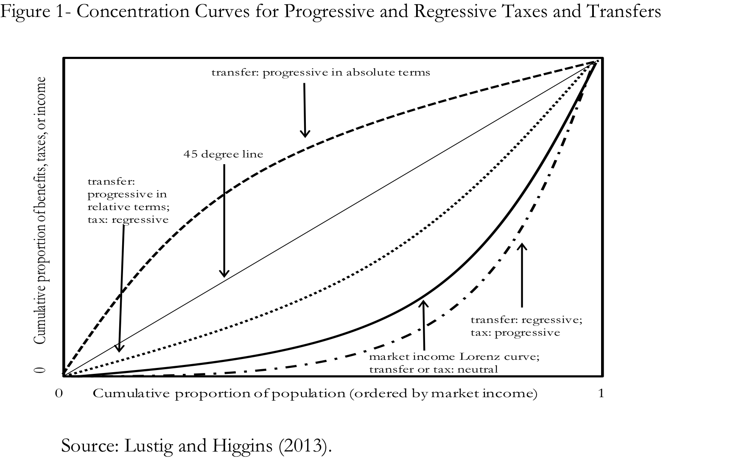

Slide 22
Assessing Characteristics of Fiscal Interventions
Scale Effect
For poor population:
  Coverage
  Per capita transfers
Horizontal inequity
For poor population:
  Incidence of a transfer (tax) higher (lower) for ethno-racial group with lower poverty rates

Slide 23
Bolivia: Post-Fiscal Income wrt Market Income

Slide 24
Why Ethno-Racial Divide is not Reduced More in Bolivia?
The indigenous population has a higher coverage rate and receives a higher per capita transfer on average than the nonindigenous.
The largest transfer program in terms of its budget is Renta Dignidad, a noncontributory universal pension for all citizens over 60 years old; in 2009 (year of the survey), this program represented 1.4 percent of GDP (Table Bolivia-8).
Because the transfer under this program is practically the same in per capita terms for all individuals of the eligible age, its concentration coefficient is around zero (Figure Bolivia-2).

Slide 25
Why Ethno-Racial Divide is not Reduced More in Bolivia?
In other words, the universal nature of the largest cash transfer in Bolivia is one of the reasons why the cash transfers programs are not able to do more to reduce the ethnic divide in terms of poverty rates and the large presence of the indigenous population among the poor.

Slide 26
Why Ethno-Racial Divide is not Reduced More in Bolivia?
This is particularly so because Bolivia does not have large-scale anti-poverty programs (such as Bolsa Familia and Oportunidades).
In fact, leaving out Renta Dignidad and Benemeritos, the government spends a paltry of .31 percent of GDP in cash transfers (Bono Juancito Pinto and Bono Juana Azurduy) and .21 percent on school feeding programs.
Clearly, children are getting the short-end of the stick in Bolivia.

Slide 27
Why Ethno-Racial Divide is not Reduced More in Brazil?

Slide 28
Why Ethno-Racial Divide is not Reduced More in Brazil?
Special Circumstances Pensions
include social protection programs against illness, disability, widowhood, orphanhood and other adverse shocks that,
although they are paid through the formal social security system to which beneficiaries need to be enrolled,
individuals can be eligible to receive the benefit even if they have not made contributions to the system (see Table Brazil-8 for a brief description of cash transfers).

Slide 29
Why Ethno-Racial Divide is not Reduced More in Brazil?
Special Circumstances Pensions Coverage: is higher for the white population and especially so among the poorest groups.
The per capita benefit is also higher for the white population as a whole and all income groups, including the poorest.
The white population also benefits more from the Scholarships program primarily because the average per capita transfer is higher.
The poorer groups among the white population have not only higher per capita transfers but also higher coverage.

Slide 30
Brazil: Post-Fiscal Income wrt Market Income

Slide 31
Uruguay: the “Poster Child”
Measured in terms of outcomes, direct taxes and cash transfers reduce quite a bit the ethno-racial divide in Uruguay in the (disposable) income space.
While poverty rates remain lower for the white population, the distance is shortened substantially.
Also, the nonwhites are no longer overrepresented among the ultra-poor and a notable share of the Afrodescendants is moved from the poor to the vulnerable and middle income class.

Slide 32
Uruguay
There are no visible ethno-racial inequities in health spending except those related to quality.
In education, the inequity is probably associated with higher repetition rates among the nonwhites as well as a lower access to tertiary education.

